Slide 1
INFOSYS SPRINGBOARD INTERNSHIP
Cloud Security Monitoring System with
Incident Management Assistance
Mentor Name: VIJAY VASANTH
Team Members: NIVETHA V, LAV SAXENA, DEEPALI SINGH, HRISHITA DEY, VINAYKUMAR, RAKESH

Slide 2
AGENDA
Presentation Overview
A simple walkthrough of what we built and how it works
1
Problem & Goals: Why cloud servers need continuous automatic monitoring
2
Tech Stack: The languages, tools, and frameworks we chose
3
Database Structure: How our database tables link to each other
4
APIs & Monitoring: How data flows and checks server health
5
Milestones 1 to 4: Step-by-step progress backed by real screenshots
6
Security & Strengths: How we protect data and key system highlights

Slide 3
THE PROBLEM
Why Server Monitoring Matters
Common issues when teams run multiple cloud servers
1
Too Many Servers: Hard to track every machine without a single dashboard
2
Slow Manual Checks: Checking servers by hand misses sudden spikes in usage
3
Unexpected Crashes: High CPU or memory can crash servers without warning
4
No Role Limits: Without roles, any user could delete an important server
5
Too Many Spam Alerts: Constant alert spam causes engineers to ignore real issues
6
Missed Emergencies: Without fast SMS, teams find out about crashes too late

Slide 4
PROJECT GOALS
What We Set Out to Build
Our main goals for a reliable monitoring platform
1
One Live Dashboard: Show all servers, CPU, RAM, and disk in one place
2
Automatic Health Checks: Check every server automatically every 60 seconds
3
Two Clear User Roles: Give Admins full control and Viewers read-only access
4
Fast Multi-Channel Alerts: Send Twilio SMS for critical alerts and email for warnings
5
Duplicate Alert Prevention: Prevents repeated OPEN alerts for the same asset and severity.
6
Smooth Login Experience: Keep users logged in without annoying session timeouts

Slide 5
TECH STACK
Tools & Technologies Used
Modern, reliable tools chosen to build a complete full-stack app
BACKEND
Java 21
Modern LTS with virtual threads & type safety
Spring Boot
REST API framework & dependency injection
Spring Data JPA
JPA/Hibernate with parameterized queries
Maven
Build automation & dependency lifecycle
Lombok
Reduces boilerplate models & accessors
DATABASE
PostgreSQL
Relational database with ACID transactions
Hibernate ORM
Automated schema generation and entity persistence
Table Links
Foreign keys linking alerts to assets
Unique Names
Unique constraints preventing duplicates
Timestamps
Audit timestamps for alert lifecycle
FRONTEND
React
Component architecture for dynamic UI
Vite
Modern build tool with instant startup
Dashboard Visualizations
Displays CPU, memory and server health information.
Axios
HTTP client with automated interceptors
SECURITY & ALERTS
Spring Security
Filter chain & method-level RBAC
JWT Tokens
Stateless 15-min access & 7-day refresh
BCrypt Hashing
Salted password hashing (cost factor 10)
Twilio SMS
Cellular SMS alerts for critical incidents
SMTP Email
Automated email alerts for warnings

Slide 6
SYSTEM ARCHITECTURE
End-to-End System Architecture Flow
Request lifecycle from user interaction through security, services, and database persistence
1. User
Browser Operator
(Admin / Viewer)
2. React
Vite Single Page App
Axios Interceptors
3. Spring Boot
REST Controller
API Entry Point
4. Spring Security
JwtAuthFilter&
Method @PreAuthorize
5. Service Layer
Asset & Alert Services
60s Scheduled Daemon
6. PostgreSQL
Relational Database
JPA Prepared Queries
➔
➔
➔
➔
➔
ARCHITECTURAL REQUEST LIFECYCLE BREAKDOWN
• Client Tier: User interacts with React SPA; Axios interceptor automatically injects JWT Bearer token into HTTP headers.
• Gateway & Security: Spring Boot routes requests through JwtAuthFilter; Spring Security validates token HMAC signature and enforces method-level @PreAuthorize RBAC.
• Service & Scheduling: Authorized requests execute business logic in Service layer; automated 60-second scheduled daemon monitors cluster health and evaluates incident rules.
• Persistence Tier: Spring Data JPA executes parameterized prepared queries with HikariCP connection pooling to safely query and persist entities in PostgreSQL.

Slide 7
BACKEND DESIGN
How the Backend Is Organized
Keeping code neat, clean, and easy to maintain
1
Separated Layers: Controllers take requests, services do work, repositories save data
2
Safe Data Objects (DTOs): Keeps database tables separate from API response data
3
Builder Pattern: Creates objects cleanly without messy long constructors
4
Safe Null Checks: Uses simple Java checks to stop app crashes when data is missing
5
Friendly Error Handler: Catches all errors and shows a clean message instead of scary code
6
Request Check Filter: Inspects the user's login token before letting any request through

Slide 8
DATABASE STRUCTURE
Database Tables & Links
Our four PostgreSQL tables and how they connect to each other
TABLE 1: infrastructure_assets (Our Servers)
• id: Primary key (BIGINT)
• asset_name: Hostname (UNIQUE)
• asset_type & ip_address: Machine type & IP
• cpu, memory, disk: Live % utilization
• asset_status: ONLINE, WARNING, CRITICAL
• cpu_alert_active & memory_alert_active: Alert state flags
TABLE 2: alerts (Connected to Server)
• id: Primary key (BIGINT)
• asset_id: Foreign key linking alert to asset
• severity: LOW, MEDIUM, HIGH, CRITICAL
• message: Incident alert description
• status: OPEN or RESOLVED (two-state)
• created_at & resolved_at: Timestamps
TABLES 3 & 4: users, roles & user_roles
• users: Username, BCrypt password, active flag
• roles: ROLE_ADMIN and ROLE_VIEWER
• user_roles: Many-to-many junction bridge table
• Default Accounts: admin & viewer logins
HOW OUR TABLES CONNECT
• One-to-Many: One server links to multiple alerts
• Many-to-Many: Users map to roles via bridge table
• SQL Safety: Parameterized JPA queries prevent injection
• ACID Persistence: Reliable transactions in PostgreSQL
• Resolution Audit: Stamped resolved_at timestamp

Slide 9
FRONTEND DESIGN
How the Frontend Works
A fast, clean React app that stays responsive
1
Fast React 18 App: Loads quickly in the browser and updates without page reloads
2
Shared Login State: Remembers if you are an Admin or Viewer across all pages
3
Automatic Token Adding: Attaches your login token to every API call behind the scenes
4
Silent Token Refresh: Gets a new token if the old one expires so you stay logged in
5
Clean Custom Theme: CSS-based styling provides cards, buttons, tables and responsive layouts.
6
Dashboard Visualizations: Displays CPU, memory and server health information through dashboard cards and visual elements.

Slide 10
API SPECIFICATION
Our Main REST APIs
Simple web endpoints that connect our frontend and backend
GET
/api/assets [Logged In]
Retrieves list of all monitored servers and live health metrics
Payload / Response: -> [ { id: 1, assetName: 'Web-01', cpuUsage: 45 } ]
POST
/api/assets [Admin Only]
Registers and provisions a new cloud infrastructure asset
Payload / Response: { assetName: 'DB-02', assetType: 'SERVER' } -> Saved
DELETE
/api/assets/{id} [Admin Only]
Decommissions and permanently deletes an asset by ID
Payload / Response: Path: id=5 -> HTTP 204 No Content (Deleted)

Slide 11
MONITORING PIPELINE
How Monitoring & Alerts Work
A simple 4-step sequence: Check -> Compare -> Alert -> Notify
1. CHECK SERVERS
Background job runs every 60s.
Polls latest metrics for all servers.
2. COMPARE USAGE
Evaluates metric thresholds:
• ≥90%: CRITICAL
• ≥80%: WARNING
• <80%:NORMAL
3. CREATE ALERT
Creates Alert record on breach.
Sets status to OPEN and links to server.
4. SEND ALERT
• Duplicate Alert Check
• CRITICAL: Twilio phone SMS
• WARNING: Email alert
• Updates dashboard badge
➔
➔
➔
REAL EXAMPLE WALKTHROUGH (END-TO-END PROOF)
1. Metric Spike: Server 'Database-01' reaches 94.5% CPU and 91% memory.
2. Classification: System identifies ≥90% threshold and marks server CRITICAL.
3. Alert Persisted: OPEN incident record saved in DB linked to 'Database-01'.
4. Duplicate Alert Check: Prevents repeated OPEN alerts for the same asset and severity.
5. SMS Dispatched: Twilio triggers immediate cellular SMS to admin mobile.
6. UI Synchronized: Dashboard updates red critical count badge immediately.

Slide 12
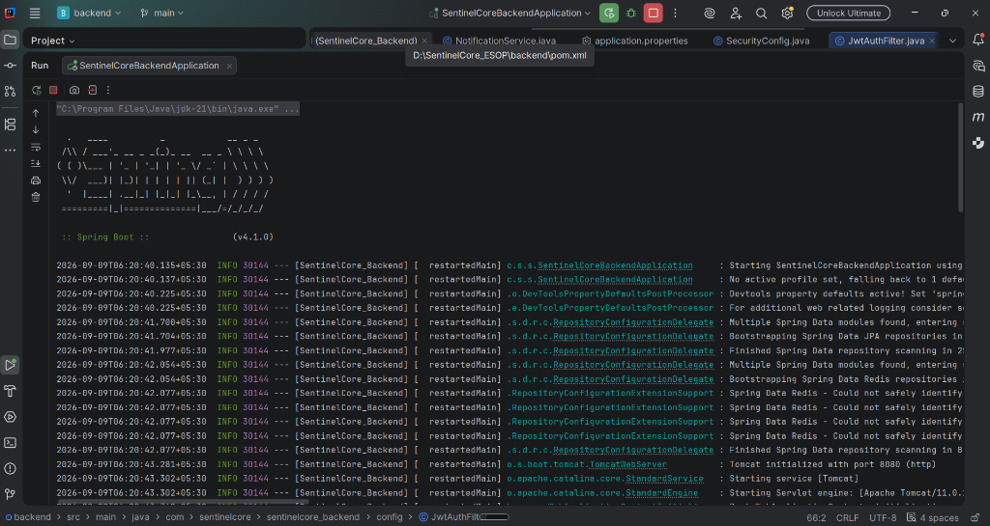
MILESTONE 1 DELIVERABLES
Milestone 1 — Initial Setup & Foundation
Starting Spring Boot, PostgreSQL, and our React frontend
▸ Project Started: Set up Java 21 and Spring Boot 4 backend
▸ Database Connected: Connected PostgreSQL with fast connection pooling
▸ Organized Folders: Separated controllers, services, and repositories
▸ First Server Table: Created table to store server names and usage metrics
▸ React App Ready: Set up React 18 with Vite for the frontend
▸ Clean Start Tested: Verified server starts up cleanly with no errors
Terminal — Spring Boot 4.1.0 & Tomcat (Port 8080)
✓ Verified: Java 21 backend and PostgreSQL connection pool initialized cleanly.

Slide 13
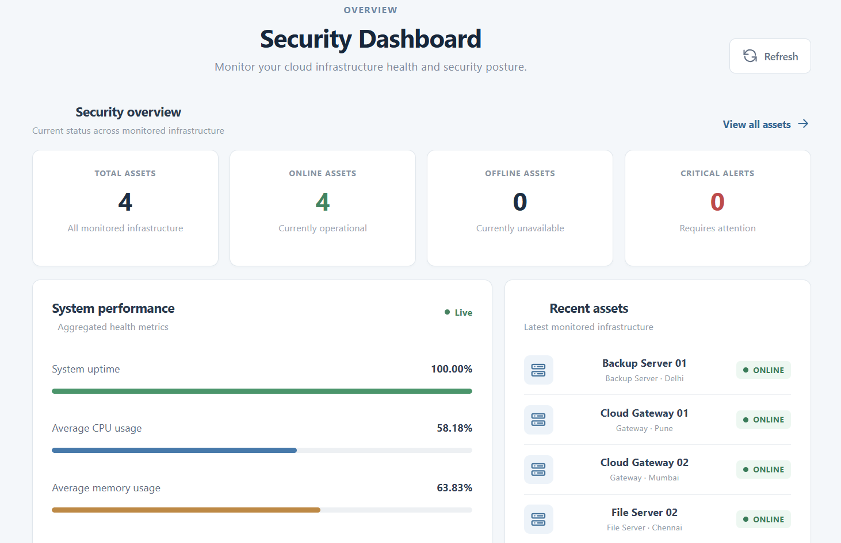
MILESTONE 2 DELIVERABLES
Milestone 2 — Server Management & Dashboard
Adding server CRUD APIs and building our live React dashboard
▸ Server CRUD APIs: Built endpoints to add, view, update, and delete servers
▸ Fast Summary Endpoint: Returns total, online, and warning counts in one call
▸ Cleaner Code: Used Java builders and simple null checks
▸ Live React Dashboard: Clean cards show online, warning, and critical servers
▸ System Performance: Dashboard metric bars show CPU, memory, and uptime at a glance.
▸ Add Server Dialog: Simple popup form to register a new server easily
Chrome — Cloud Security Monitoring Dashboard (port 5173)
✓ Verified: Live dashboard tracks 12 assets with 91.67% uptime and performance metrics.

Slide 14
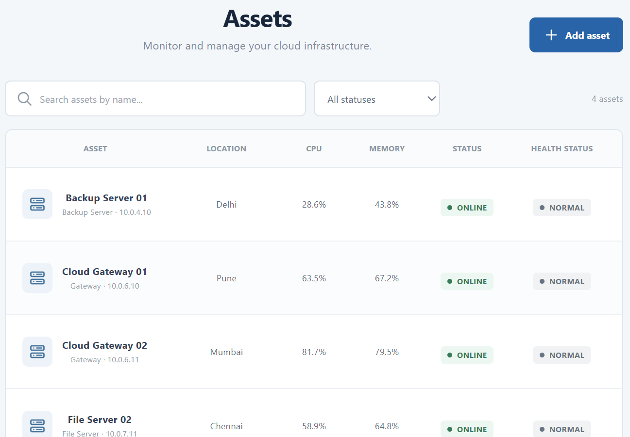
MILESTONE 3 DELIVERABLES
Milestone 3 — Automatic Health Checks & Alerts
A background timer that checks health and saves alert tickets
▸ 60-Second Auto Check: Background job checks all servers every minute
▸ Simple Rule Check: Flags servers as Warning at 80% and Critical at 90%
▸ Alerts Saved to DB: Saves open alert tickets linked to the problematic server
▸ Alert Lifecycle: Tracks whether an alert is Open or Resolved
▸ Resolve Alert Button: Lets an admin mark an issue as fixed
▸ Basic Login Guard: Added initial token checks to protected monitoring APIs
Dashboard — Current Assets & Automated Critical Incident
✓ Verified: Automated incident lifecycle (OPEN → RESOLVED) verified end-to-end.

Slide 15
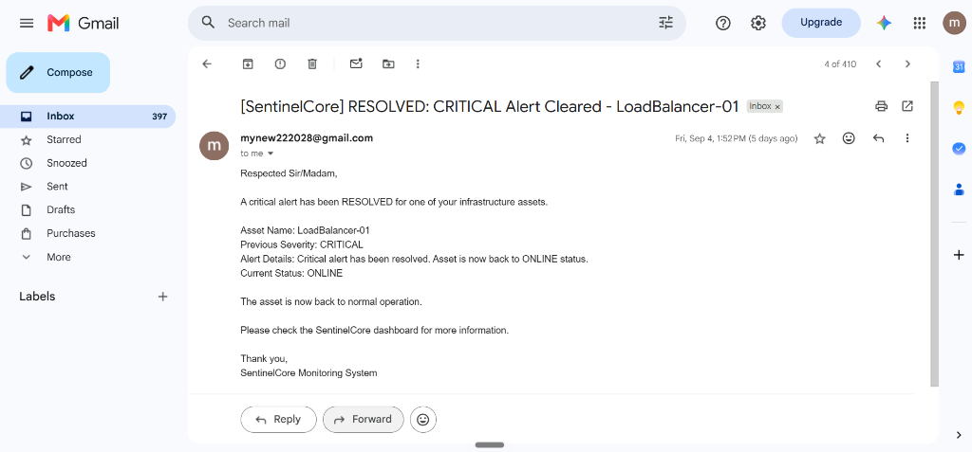
MILESTONE 4 DELIVERABLES
Milestone 4 — Login Roles & Phone SMS Alerts
Two-token login, Admin vs Viewer permissions, and Twilio SMS
▸ Two-Token Login: 15-minute access token and 7-day refresh token
▸ Admin vs Viewer Roles: Admins have full edit buttons; Viewers can only look
▸ Backend Permission Checks: Server stops Viewers from calling add or delete endpoints
▸ Automatic Token Refresh: Frontend keeps users logged in without annoying interruptions
▸ Real Twilio Phone SMS: Sends an emergency text message for critical issues
▸ Duplicate Alert Prevention: Prevents repeated OPEN alerts for the same asset and severity.
Gmail — Automated Incident Alert Delivered [SMTP]
✓ Verified: Automated out-of-band email notification delivered to admin inbox.

Slide 16
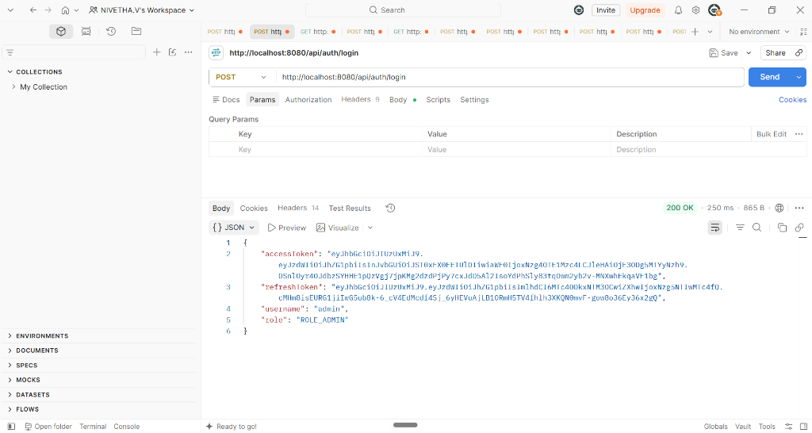
TESTING PROOF
Postman Testing Evidence
Real API tests showing status codes, tokens, and role restrictions
▸ Complete Postman Suite: Tested all login, server, and alert endpoints thoroughly
▸ Status 200 OK Confirmed: Verified that correct requests return clean JSON data
▸ Status 401 Block Confirmed: Rejects requests without login tokens immediately
▸ Status 403 Forbidden Confirmed: Proves Viewers cannot delete or add servers
▸ Token Refresh Confirmed: Proves sending a refresh token gives back a new access token
▸ Database Updated Confirmed: Confirmed database values match the API test results
▸ Role-Based Access Control Proof: Viewer role → 403 Forbidden, Admin role → 200 OK
Postman — POST /api/auth/login [Status: 200 OK • 250ms]
✓ Verified: HTTP 200 OK with dual JWT tokens (15-min access & 7-day refresh).

Slide 17
SECURITY SETUP
How We Keep the System Safe
Simple, solid protections across passwords, tokens, and database
1
Scrambled Passwords: Passwords hashed with BCrypt so they are never plain text
2
Short 15-Minute Tokens: Limits damage even if a token is accidentally leaked
3
Server-Side Role Checks: Checks user roles on the backend so users cannot bypass UI
4
Safe Database Queries: Spring Data JPA uses parameterized queries for repository operations, reducing SQL injection risks.
5
Hidden Error Details: Hides technical database errors so attackers cannot inspect them
6
Duplicate Alert Prevention: Prevents duplicate OPEN alerts for the same asset and severity.

Slide 18
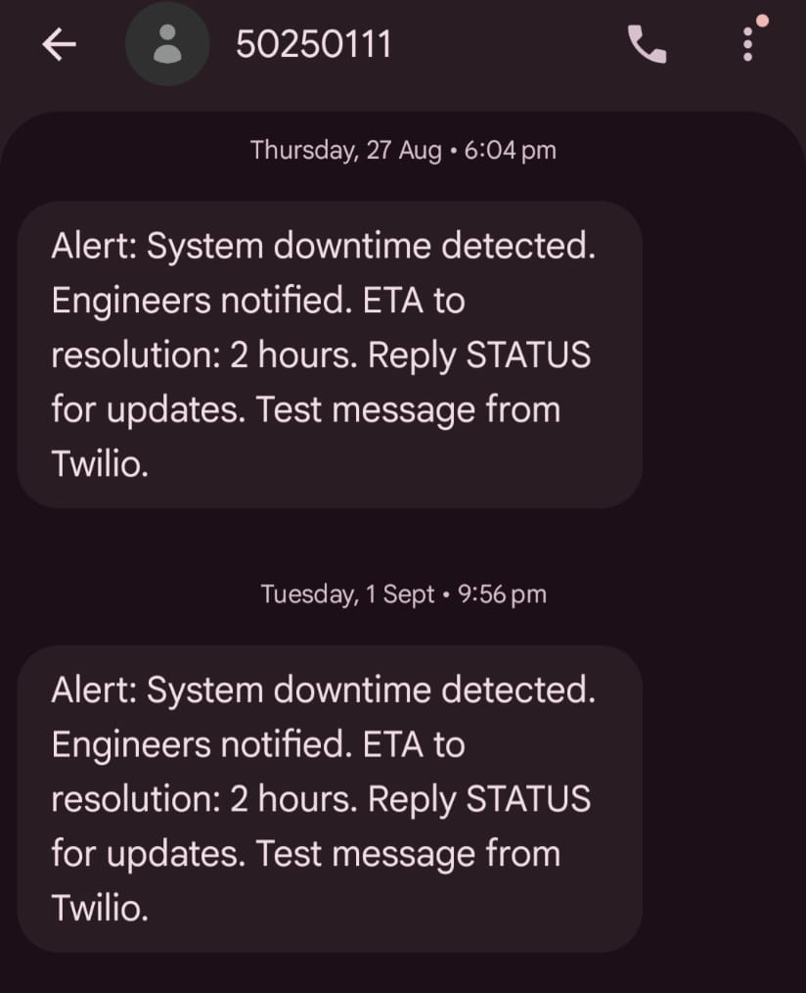
CHALLENGES FACED
Problems We Solved & What We Learned
Practical solutions to challenges we faced during the project
▸ Double Token Refresh: Queued API calls prevent duplicate refresh requests.
▸ Duplicate Alert Prevention: Prevented repeated OPEN alerts for the same asset and severity.
▸ Keeping Screen Updated: Connected background checks smoothly without reload.
▸ Messy Database Errors: Central error handler masks internal DB error details.
▸ Hiding Private Keys: Stored Twilio API keys and mail passwords in local config.
▸ Faster Screen Loading: Aggregated summary DTO loads metrics in one call.
SMS — Automated Incident Alert Delivered [Twilio]
✓ Verified: Automated cellular notification delivered to adminitrator

Slide 19
SYSTEM VALUE
Key System Highlights & Strengths
How our monitoring platform delivers real-world reliability
1
60-Second Scheduled Checks: Background job polls every server every 60 seconds.
2
Instant Crisis Alerts: Twilio SMS alerts admins immediately during critical incidents.
3
Duplicate Alert Prevention: Prevents duplicate OPEN alerts for the same asset and severity.
4
Strict Role Boundaries: Backend enforces Admin edit rights and Viewer read-only access.
5
Protected Server Data: Parameterized JPA queries prevent SQL injection risks.
6
Fast Visual Dashboard: Real-time metric bars and status cards give cluster health at a glance.

Slide 20
FUTURE VISION
Future Scope and Improvements
Building a smarter and more reliable server monitoring platform
1
AI-Based Predictive Monitoring
Predict potential server failures by analysing historical CPU, memory, and health data.
2
Advanced Analytics & Visualization
Add detailed performance graphs, trends, and customizable dashboards for better insights.
3
Scalable Multi-Server Support
Extend monitoring to large-scale server environments and cloud infrastructure.
4
Mobile Application
Provide real-time monitoring, alerts, and server controls through a mobile app.
5
Anomaly Detection
Identify unusual server behaviour beyond fixed CPU, memory, or health thresholds.
6
Automated Incident Recovery
Automatically restart failed services or servers and perform predefined recovery actions.

Slide 21
SUMMARY
Project Summary & Conclusion
All four milestones completed, tested, and ready
1
All 4 Milestones Finished: Successfully built, linked, and tested every assigned feature
2
Reliable Server Checks: 60-second automatic timer spots high CPU and RAM usage
3
Clean Database Design: PostgreSQL tables keep servers, alerts, and roles organized
4
Real Role Security: Admins can edit and Viewers can only view safely
5
Fast Phone SMS Alerts: Twilio SMS and email make sure emergencies are never missed
6
Proven with Tests: Automated Postman tests confirm everything works properly

Slide 22
Thank You!
Cloud Security Monitoring System with Incident Management Assistance

